Slide 1
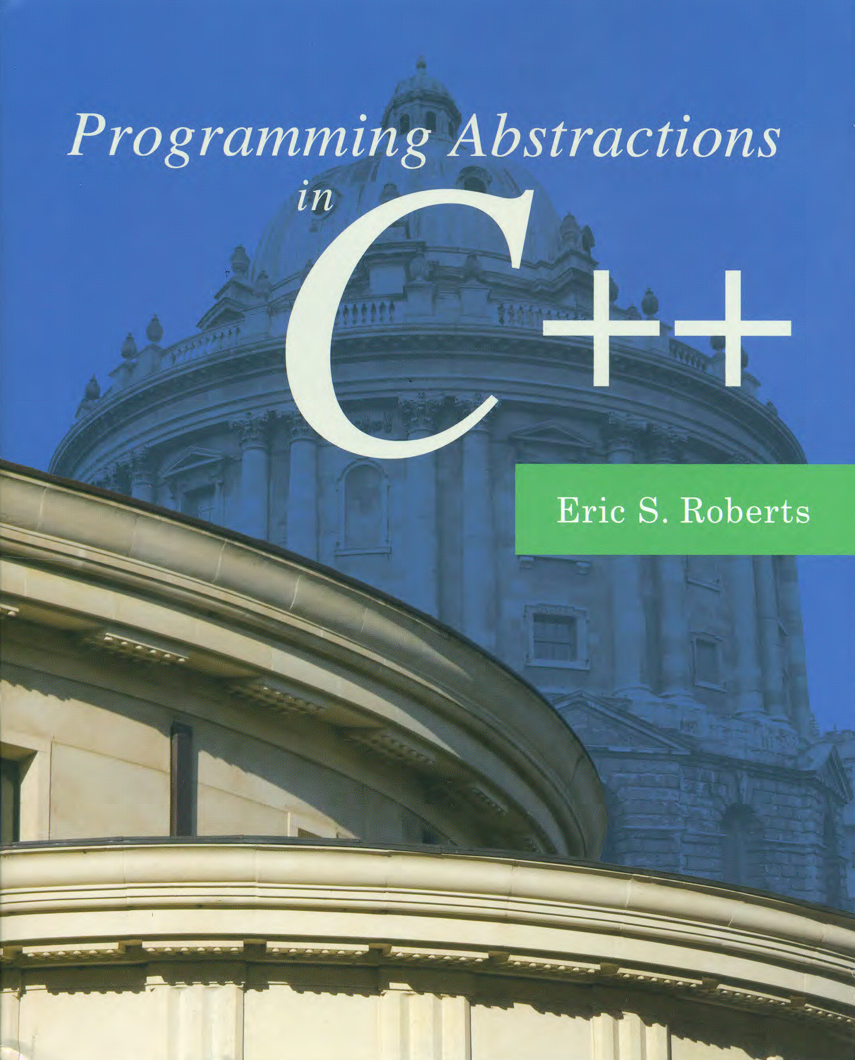
Strategies for Iteration
C H A P T E R 20
What needs this iteration.
—William Shakespeare, Othello, ~1603
20.1 Using iterators
20.2 Using functions as data values
20.3 Encapsulating data with functions
20.4 The STL algorithm library
20.5 Functional programming in C++
20.6 Implementing iterators

Slide 2
Using Iterators in C++
The C++ Standard Template Library makes extensive use of an abstract data type called an iterator, which supports stepping through a collection one element at a time.
Every collection class in the STL exports an iterator type along with two standard methods that produce iterators. The begin method returns an iterator positioned at the beginning of the collection. The end method returns an iterator positioned just past the final element.
Iterators in C++ use a syntax derived from pointers. Given an iterator, one reads the corresponding value by dereferencing the iterator variable and increments it using the ++ operator. The pattern for using an iterator to loop over a collection c is
for (type::iterator it = c.begin(); it < c.end(); it++) {
. . . Body of loop involving *it . . .
}

Slide 3
The C++ Iterator Hierarchy
InputIterator
OutputIterator
*it
it++
it->field
*it = value
it++
it₁ == it₂
it₁ != it₂
it₁ == it₂
it₁ != it₂
ForwardIterator
BidirectionalIterator
it--
RandomAccessIterator
it + n
it – n
it += n
it -= n
it₁ – it₂
it₁ < it₂
it₁ <= it₂
it₁ > it₂
it₁ >= it₂

Slide 4
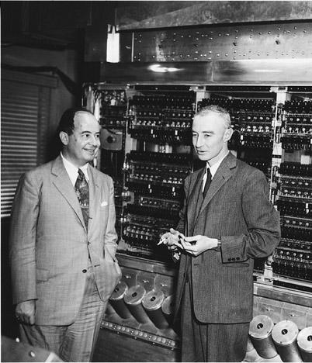
The von Neumann Architecture
One of the foundational ideas of modern computing—traditionally attributed to John von Neumann although others can make valid claims to the idea—is that code is stored in the same memory as data. This concept is called the stored programming model.
If you go on to take CS 107, you will learn more about how code is represented inside the computer. For now, the important idea is that the code for every C++ function is stored somewhere in memory and therefore has an address.
0000
0004
int main() {
cout << "hello";
cout << endl;
return 0;
}
0008
000C
0010
0014
0018
001C
0020
0024
0028
.
.
.
002C
FFD0
FFD4
FFD8
FFDC
FFE0
FFE4
John von Neumann and J. Robert Oppenheimer
FFE8
FFEC
FFF0
FFF4
FFF8
FFFC

Slide 5
Callback Functions
The ability to determine the address of a function makes it possible to pass functions as parameters to other functions.
In this example, the function main makes two calls to plot.
The first call passes the address of sin, which is 0028.
The second passes the address of cos, which is 0044.
The plot function can call this function supplied by the caller. Such functions are known as callback functions.
int main() {
GWindow gw;
plot(gw, sin, . . .);
plot(gw, cos, . . .);
return 0;
}
0000
0004
0008
000C
0010
0014
0018
001C
0020
double sin(double x) {
. . . code to compute sin(x) . . .
}
0024
0028
002C
0030
0034
0038
003C
double cos(double x) {
. . . code to compute cos(x) . . .
}
0040
0044
0048
004C
0050
0054
0058
005C
0060
0064

Slide 6
Function Pointers in C++
One of the hardest aspects of function pointers in C++ is writing the type for the function used in its declaration.
The syntax for declaring function pointers is consistent with the syntax for other pointer declarations, although it takes some getting used to. Consider the following declarations:
double x;
Declares x as a double.
double *px;
Declares px as a pointer to a double.
double f();
Declares f as a function returning a double.
double *g();
Declares g as a function returning a pointer to a double.
double (*proc)();
Declares proc as a pointer to a procedure returning a double.
double (*fn)(double);
Declares fn as a pointer to a function taking and returning a double.

Slide 7
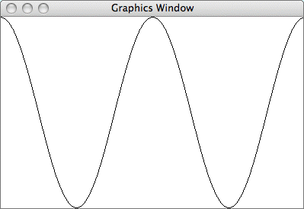
Plotting a Function
Section 20.2 defines a plot function that draws the graph of a function on the graphics window.
The arguments to plot are the graphics window, the function, and the limits in the x and y directions. For example, calling
plot(gw, cos, -2 * PI, 2 * PI, -1.0, 1.0);
produces the following output:

Slide 8
Exercise: Defining the plot Function
1.
What is the prototype for the plot function?
void plot(GWindow & gw, double (*fn)(double),
void plot(GWindow & gw, double minX, double maxX,
void plot(GWindow & gw, double minY, double maxY);
2.
How would you convert values x and y in the mathematical domain into screen points sx and sy?
Hint: In the time that x moves from minX to maxX, sx must move from 0 to gw.getWidth(); y must move in the opposite direction from gw.getHeight() to 0.
double width = gw.getWidth();
double height = gw.getHeight();
double sx = (x - minX) / (maxX - minX) * width;
double sy = height - (y - minY) / (maxY - minY) * height;

Slide 9
Exercise: Dispatch Strategies
In your implementation of BASIC, you presumably have a function that looks something like this:
Statement *parseStatement(TokenScanner & scanner) {
string token = toUpperCase(scanner.nextToken());
if (token == "REM") return new RemStmt(scanner);
if (token == "LET") return new LetStmt(scanner);
if (token == "PRINT") return new PrintStmt(scanner);
if (token == "INPUT") return new InputStmt(scanner);
if (token == "GOTO") return new GotoStmt(scanner);
if (token == "IF") return new IfStmt(scanner);
if (token == "END") return new EndStmt(scanner);
error("Unrecognized statement: " + token);
}
This strategy would become problematic if there were more statement types or if those types could expand dynamically. How might you restructure this implementation so that the size of the code did not depend on the number of statements?

Slide 10
Mapping Functions
The ability to work with pointers to functions offers one solution to the problem of iterating through the elements of a collection. To use this approach, the collection must export a mapping function that applies a client-specified function to every element of the collection.
Most collections in the Stanford libraries export the method
template <typename ValueType>
void mapAll(void (*fn)(ValueType));
that calls fn on every element of the collection.
As an example, you can print the elements of a Set<int> s, by calling s.mapAll(printInt) where printInt is
void printInt(int n) {
cout << n << endl;
}

Slide 11
Exercise: Implement mapAll
Implement the function
void mapAll(void (*fn)(string));
as part of the StringMap class, for which the private section looks like this:
/* Type definition for cells in the bucket chain */
struct Cell {
std::string key;
std::string value;
Cell *link;
};
/* Constant definitions */
static const int INITIAL_BUCKET_COUNT = 13;
/* Instance variables */
Cell **buckets; /* Dynamic array of pointers to cells */
int nBuckets; /* The number of buckets in the array */

Slide 12
Passing Data to Mapping Functions
The biggest problem with using mapping functions is that it is difficult to pass client information from the client back to the callback function. The C++ packages that support callback functions typically support two different strategies for achieving this goal:
1.
Passing an additional argument to the mapping function, which is then included in the set of arguments to the callback function.
2.
Passing a function object to the mapping function. A function object is simply any object that overloads the function-call operator, which is designated in C++ as operator().
For the last bit of today’s class, I’ll go through each of these strategies in the context of a program that writes out every word in the English lexicon that has a particular length.

Slide 13
Methods in the algorithm Library
max(x, y)
Returns the greater of x and y.
min(x, y)
Returns the lesser of x and y.
swap(x, y)
Swaps the reference parameters x and y.
iter_swap(i₁, i₂)
Swaps the values addressed by the iterators i₁ and i₂.
binary_search(begin, end, value)
Returns true if the iterator range contains the specified value.
copy(begin, end, out)
Copies the iterator range to the output iterator.
count(begin, end, value)
Counts the number of values in the iterator range that are equal to value.
fill(begin, end, value)
Sets every element in the iterator range to value.

Slide 14
Methods in the algorithm Library
find(begin, end, value)
Returns an iterator to the first element in the iterator range that is equal to value.
merge(begin₁, end₁, begin₂, end₂, out)
Merges the sorted input sequences into the output iterator.
min_element(begin, end)
Returns an iterator to the smallest element in the iterator range.
max_element(begin, end)
Returns an iterator to the largest element in the iterator range.
random_shuffle(begin, end)
Randomly reorders the elements in the iterator range.
replace(begin, end, old, new)
Replaces all occurrences of old with new in the iterator range.
reverse(begin, end)
Reverses the elements in the iterator range.
sort(begin, end)
Sorts the elements in the iterator range.

Slide 15
Methods in the algorithm Library
for_each(begin, end, fn)
Calls fn on every value in the iterator range.
count_if(begin, end, pred)
Returns the number of elements in the iterator range for which pred is true.
replace_if(begin, end, pred, new)
Replaces every element in the iterator range for which pred is true by new.
partition(begin, end, pred)
Reorders the elements in the iterator range so that the pred elements come first.

Slide 16
Classes in the functional Library
binary_function<argtype₁, argtype₂, resulttype>
Superclass for functions that take the two argument types and return a resulttype.
unary_function<argtype, resulttype>
Superclass for functions that take one argtype and return a resulttype.
plus<type>
Binary function implementing the + operator.
minus<type>
Binary function implementing the - operator.
multiplies<type>
Binary function implementing the * operator.
divides<type>
Binary function implementing the / operator.
modulus<type>
Binary function implementing the % operator.
negate<type>
Unary function implementing the - operator.

Slide 17
Classes in the functional Library
equal_to<type>
Function class implementing the == operator.
not_equal_to<type>
Function class implementing the != operator.
less<type>
Function class implementing the < operator.
less_equal<type>
Function class implementing the <= operator.
greater<type>
Function class implementing the > operator.
greater_equal<type>
Function class implementing the >= operator.
logical_and<type>
Function class implementing the && operator.
logical_or<type>
Function class implementing the || operator.
logical_not<type>
Function class implementing the ! operator.

Slide 18
Methods in the functional Library
bind1st(fn, value)
Returns a unary counterpart to the binary fn in which the first argument is value.
bind2nd(fn, value)
Returns a unary counterpart to fn in which the second argument is value.
not1(fn)
Returns a unary predicate function which has the opposite result of fn.
not2(fn)
Returns a binary predicate function which has the opposite result of fn
ptr_fun(fnptr)
Converts a function pointer to the corresponding function object.

Slide 19
Implementation of the Vector Iterator
/*
* Nested class: iterator
* ----------------------
* This nested class implements a standard iterator for the Vector class.
*/
class iterator {
public:
/*
* Implementation notes: iterator constructor
* ------------------------------------------
* The default constructor for the iterator returns an invalid iterator
* in which the vector pointer vp is set to NULL. Iterators created by
* the client are initialized by the constructor iterator(vp, k), which
* appears in the private section.
*/
iterator() {
this->vp = NULL;
}

Slide 20
Implementation of the Vector Iterator
/*
* Implementation notes: dereference operator
* ------------------------------------------
* The * dereference operator returns the appropriate index position in
* the internal array by reference.
*/
ValueType & operator*() {
if (vp == NULL) error("Iterator is uninitialized");
if (index < 0 || index >= vp->count) error("Iterator out of range");
return vp->array[index];
}
/*
* Implementation notes: -> operator
* ---------------------------------
* Overrides of the -> operator in C++ follow a special idiomatic pattern.
* The operator takes no arguments and returns a pointer to the value.
* The compiler then takes care of applying the -> operator to retrieve
* the desired field.
*/
ValueType *operator->() {
if (vp == NULL) error("Iterator is uninitialized");
if (index < 0 || index >= vp->count) error("Iterator out of range");
return &vp->array[index];
}
/*
* Nested class: iterator
* ----------------------
* This nested class implements a standard iterator for the Vector class.
*/
class iterator {
public:
/*
* Implementation notes: iterator constructor
* ------------------------------------------
* The default constructor for the iterator returns an invalid iterator
* in which the vector pointer vp is set to NULL. Iterators created by
* the client are initialized by the constructor iterator(vp, k), which
* appears in the private section.
*/
iterator() {
this->vp = NULL;
}

Slide 21
Implementation of the Vector Iterator
/*
* Implementation notes: selection operator
* ----------------------------------------
* The selection operator returns the appropriate index position in
* the internal array by reference.
*/
ValueType & operator[](int k) {
if (vp == NULL) error("Iterator is uninitialized");
if (index + k < 0 || index + k >= vp->count) {
error("Iterator out of range");
}
return vp->array[index + k];
}
/*
* Implementation notes: relational operators
* ------------------------------------------
* These operators compare the index field of the iterators after making
* sure that the iterators refer to the same vector.
*/
bool operator==(const iterator & rhs) {
if (vp != rhs.vp) error("Iterators are in different vectors");
return vp == rhs.vp && index == rhs.index;
}
/*
* Implementation notes: dereference operator
* ------------------------------------------
* The * dereference operator returns the appropriate index position in
* the internal array by reference.
*/
ValueType & operator*() {
if (vp == NULL) error("Iterator is uninitialized");
if (index < 0 || index >= vp->count) error("Iterator out of range");
return vp->array[index];
}
/*
* Implementation notes: -> operator
* ---------------------------------
* Overrides of the -> operator in C++ follow a special idiomatic pattern.
* The operator takes no arguments and returns a pointer to the value.
* The compiler then takes care of applying the -> operator to retrieve
* the desired field.
*/
ValueType *operator->() {
if (vp == NULL) error("Iterator is uninitialized");
if (index < 0 || index >= vp->count) error("Iterator out of range");
return &vp->array[index];
}

Slide 22
Implementation of the Vector Iterator
bool operator!=(const iterator & rhs) {
if (vp != rhs.vp) error("Iterators are in different vectors");
return !(*this == rhs);
}
bool operator<(const iterator & rhs) {
if (vp != rhs.vp) error("Iterators are in different vectors");
return index < rhs.index;
}
bool operator<=(const iterator & rhs) {
if (vp != rhs.vp) error("Iterators are in different vectors");
return index <= rhs.index;
}
bool operator>(const iterator & rhs) {
if (vp != rhs.vp) error("Iterators are in different vectors");
return index > rhs.index;
}
bool operator>=(const iterator & rhs) {
if (vp != rhs.vp) error("Iterators are in different vectors");
return index > rhs.index;
}
/*
* Implementation notes: selection operator
* ----------------------------------------
* The selection operator returns the appropriate index position in
* the internal array by reference.
*/
ValueType & operator[](int k) {
if (vp == NULL) error("Iterator is uninitialized");
if (index + k < 0 || index + k >= vp->count) {
error("Iterator out of range");
}
return vp->array[index + k];
}
/*
* Implementation notes: relational operators
* ------------------------------------------
* These operators compare the index field of the iterators after making
* sure that the iterators refer to the same vector.
*/
bool operator==(const iterator & rhs) {
if (vp != rhs.vp) error("Iterators are in different vectors");
return vp == rhs.vp && index == rhs.index;
}

Slide 23
Implementation of the Vector Iterator
/*
* Implementation notes: ++ and -- operators
* -----------------------------------------
* These operators increment or decrement the index. The suffix versions
* of the operators, which are identified by taking a parameter of type
* int that is never used, are more complicated and must copy the original
* iterator to return the value prior to changing the count.
*/
iterator & operator++() {
if (vp == NULL) error("Iterator is uninitialized");
index++;
return *this;
}
iterator operator++(int) {
iterator copy(*this);
operator++();
return copy;
}
bool operator!=(const iterator & rhs) {
if (vp != rhs.vp) error("Iterators are in different vectors");
return !(*this == rhs);
}
bool operator<(const iterator & rhs) {
if (vp != rhs.vp) error("Iterators are in different vectors");
return index < rhs.index;
}
bool operator<=(const iterator & rhs) {
if (vp != rhs.vp) error("Iterators are in different vectors");
return index <= rhs.index;
}
bool operator>(const iterator & rhs) {
if (vp != rhs.vp) error("Iterators are in different vectors");
return index > rhs.index;
}
bool operator>=(const iterator & rhs) {
if (vp != rhs.vp) error("Iterators are in different vectors");
return index > rhs.index;
}

Slide 24
Implementation of the Vector Iterator
iterator & operator--() {
if (vp == NULL) error("Iterator is uninitialized");
index--;
return *this;
}
iterator operator--(int) {
iterator copy(*this);
operator--();
return copy;
}
/*
* Implementation notes: arithmetic operators
* ------------------------------------------
* These operators update the index field by the increment value k.
*/
iterator operator+(const int & k) {
if (vp == NULL) error("Iterator is uninitialized");
return iterator(vp, index + k);
}
iterator operator-(const int & k) {
if (vp == NULL) error("Iterator is uninitialized");
return iterator(vp, index - k);
}
/*
* Implementation notes: ++ and -- operators
* -----------------------------------------
* These operators increment or decrement the index. The suffix versions
* of the operators, which are identified by taking a parameter of type
* int that is never used, are more complicated and must copy the original
* iterator to return the value prior to changing the count.
*/
iterator & operator++() {
if (vp == NULL) error("Iterator is uninitialized");
index++;
return *this;
}
iterator operator++(int) {
iterator copy(*this);
operator++();
return copy;
}

Slide 25
Implementation of the Vector Iterator
int operator-(const iterator & rhs) {
if (vp == NULL) error("Iterator is uninitialized");
if (vp != rhs.vp) error("Iterators are in different vectors");
return index - rhs.index;
}
/* Private section */
private:
const Vector *vp; /* Pointer to the Vector object */
int index; /* Index for this iterator */
/*
* Implementation notes: private constructor
* -----------------------------------------
* The begin and end methods use the private constructor to create iterators
* initialized to a particular position. The Vector class must therefore be
* declared as a friend so that begin and end can call this constructor.
*/
iterator(const Vector *vp, int index) {
this->vp = vp;
this->index = index;
}
friend class Vector;
};
iterator & operator--() {
if (vp == NULL) error("Iterator is uninitialized");
index--;
return *this;
}
iterator operator--(int) {
iterator copy(*this);
operator--();
return copy;
}
/*
* Implementation notes: arithmetic operators
* ------------------------------------------
* These operators update the index field by the increment value k.
*/
iterator operator+(const int & k) {
if (vp == NULL) error("Iterator is uninitialized");
return iterator(vp, index + k);
}
iterator operator-(const int & k) {
if (vp == NULL) error("Iterator is uninitialized");
return iterator(vp, index - k);
}

Slide 26
The End

